Slide 1
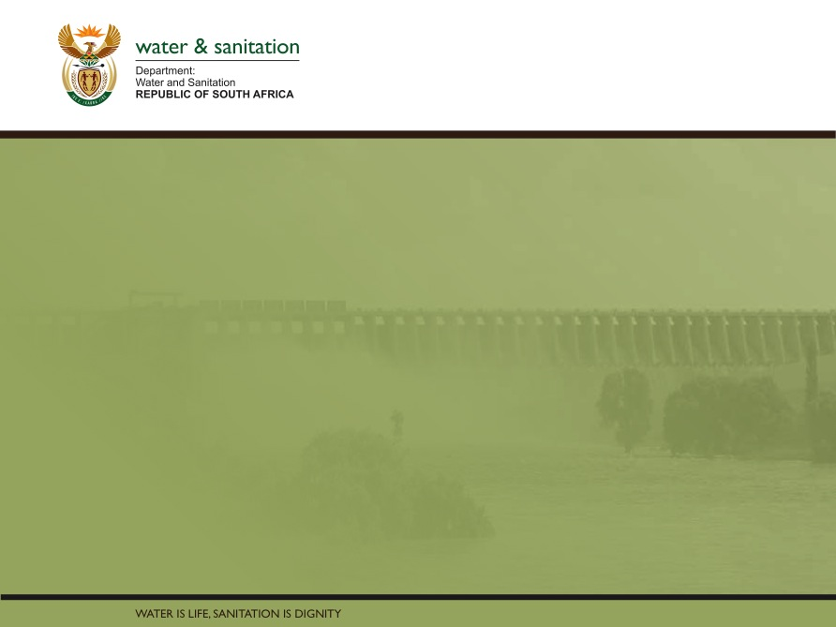
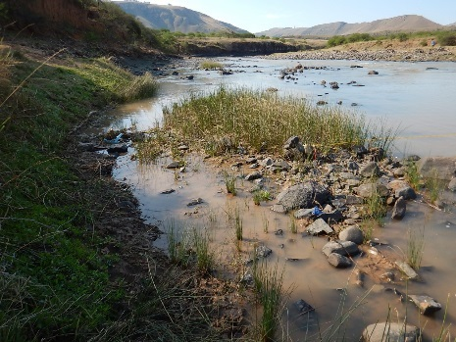
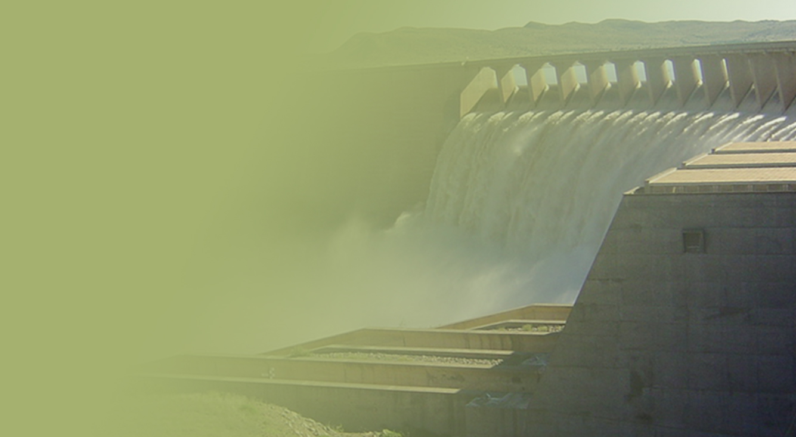
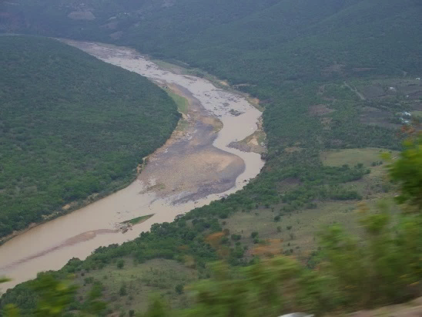
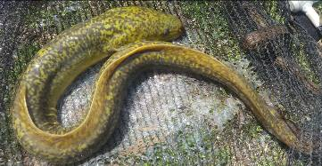
WP 11004: PSC MEETING 4,
15 MAY 2018
PRESENTATION TITLE
Presented by:
Name Surname
Directorate
Date
DETERMINATION OF WATER RESOURCE CLASSES AND RESOURCE QUALITY OBJECTIVES FOR THE WATER RESOURCES IN THE MZIMVUBU CATCHMENT:
RIVER RESOURCE QUALITY OBJECTIVES + USER WQ
Delana Louw + Patsy Scherman

Slide 2
WHERE DO YOU SET RQOs?
In Resource Units (homogeneous river reach which can be represented by an EWR site):
RQOs can be set for each Resource Unit – at a minimum at high priority RUs
Resource Units must be prioritised, and high priority Resource Units must have detailed RQOs
Four (4) Resource Unit priority level of RQOs have been determined – links to hotspots
Different levels of RQOs are set for each priority level
NB: Provide some level of RQO for each RU

Slide 3
PRIORITIZATIONS OF RUs
RU priority levels based on:
Outcome of the hotspot assessment
Available information + associated confidence

Slide 4
FOR WHICH INDICATORS ARE RQOs SET?
Hydrology (flow): Quantity, pattern and timing of instream flow (repr. by time series, FDC). Defined by the recommended scenario.
Water quality: Narrative + numerical values that define the fitness of use and/or ecological requirements for various variables.
Characteristics and condition of riparian habitat and biota (% alien vegetation, cover, species).
Characteristics and condition of instream habitat and biota (frequency of occurrence, species/taxa, abundance, habitat).
NOTE: Not all RQOs are set for all RUs – depends on priority and indicators selected.

Slide 5
ECOLOGICAL CLASSIFICATION
Ecological status described in terms of Ecological Categories:
  A – near natural
  B – largely natural
  C – moderately modified
  D – largely modified
  E – seriously modified
  F - critically modified

Slide 6
High Priority RUs (3 or 4): High level
of detail (if it includes EWR site). EcoSpecs are set for the following:
Hydrology
Physico-chemical variables (water quality)
- also for High Priority 3WQ and 4WQ
Geomorphology (EWR sites only)
Riparian vegetation
Fish
Macroinvertebrates
Habitat integrity

Slide 7
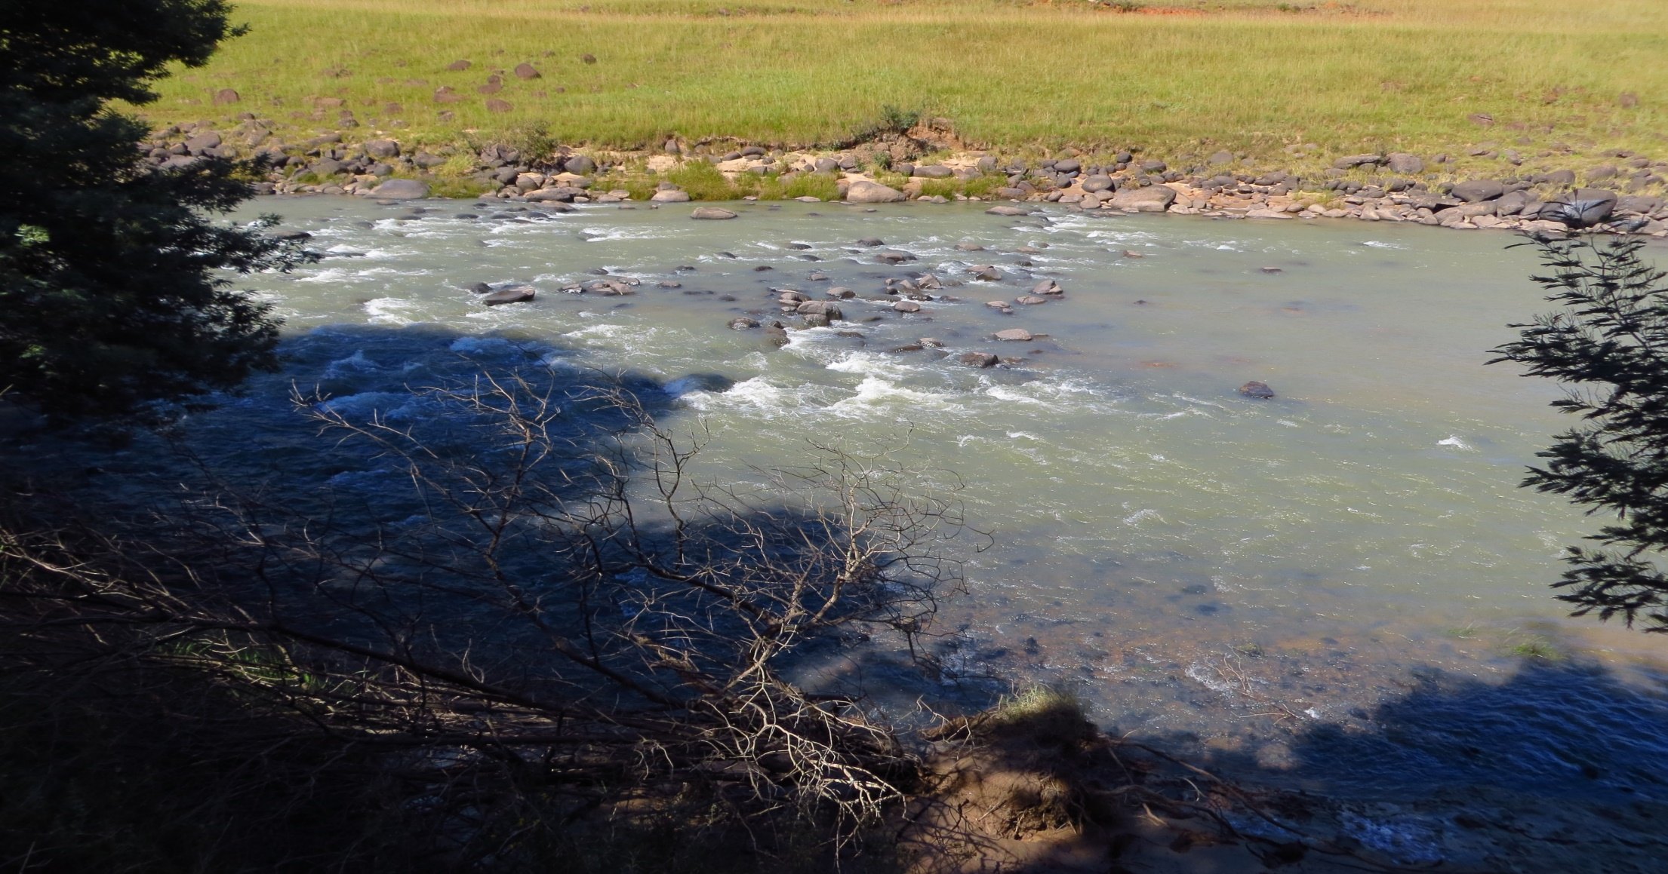
TSITSA RIVER - MZIMEWR1
 |  | PES | TEC
Hydrology | nMAR% | 31 | 31
 | Drought (90%) Aug | 0.66 m³/s | 0.66 m³/s
 | Aug (60%) | 0.8 m³/s | 0.8 m³/s
Habitat & Biota (EcoStatus C) | Geomorph | C/D | D
 | Fish | C | C
 | Invertebrates | C | C
 | Vegetation | C/D | D

Slide 8
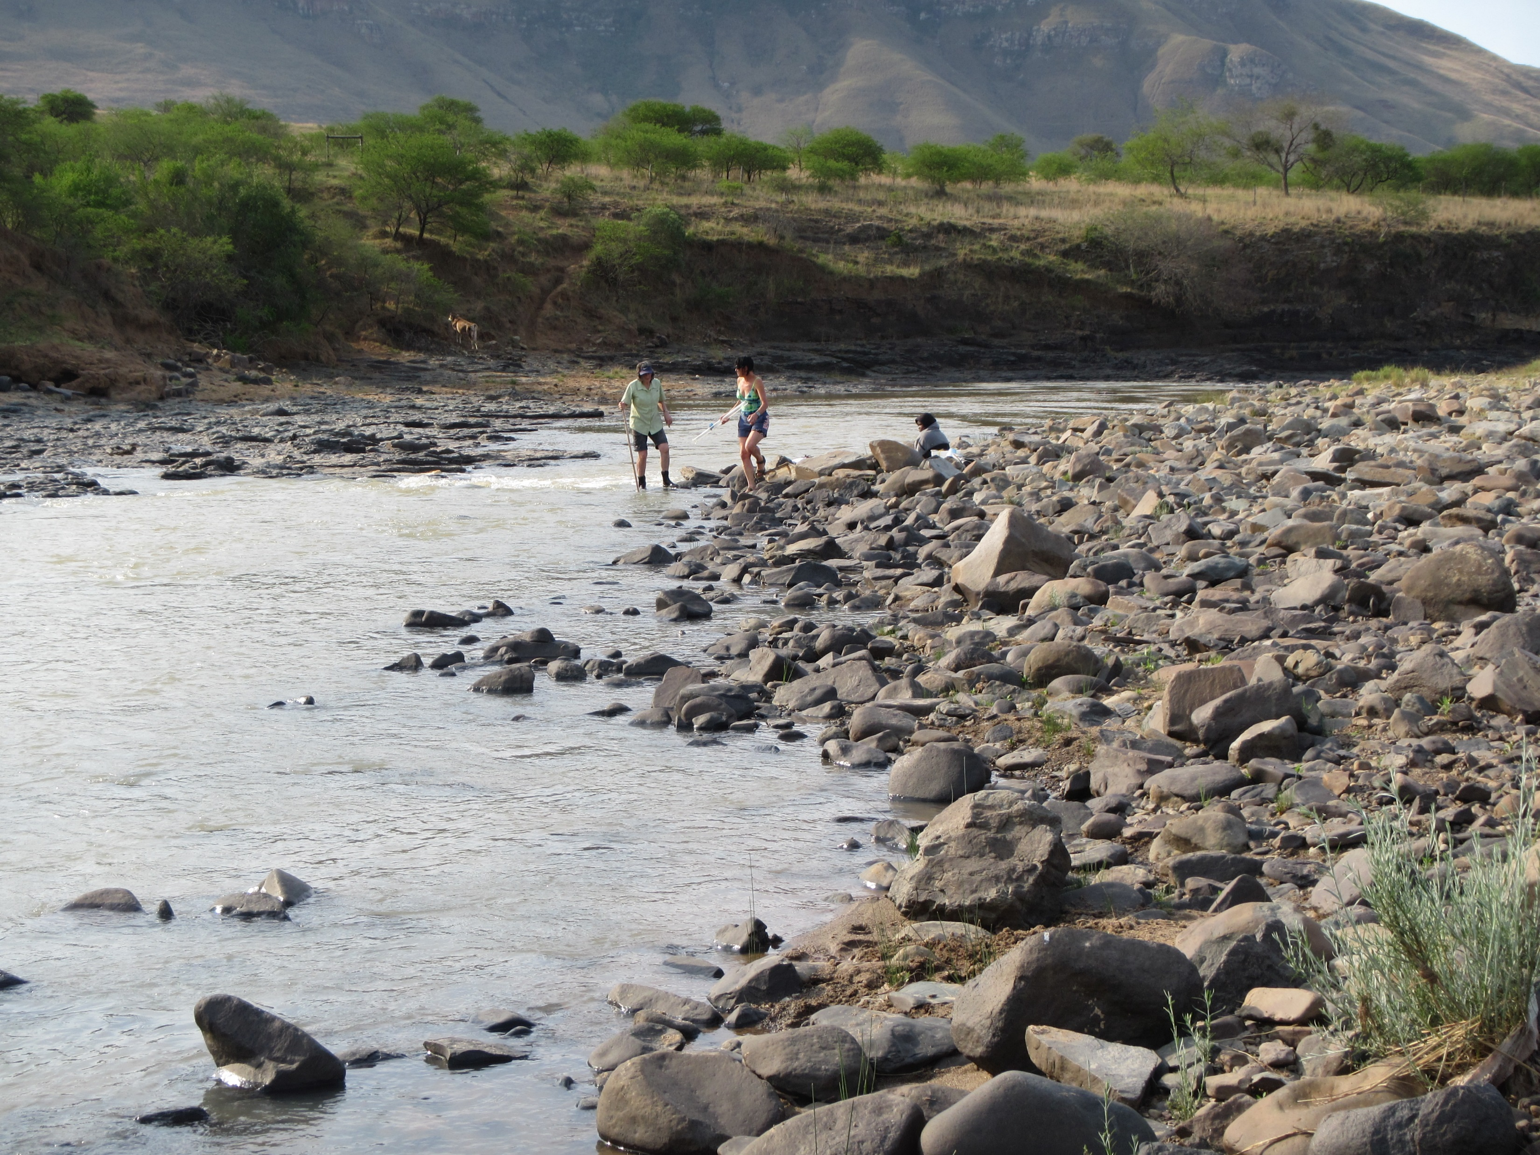
THINA RIVER - MZIMEWR 2
 |  | PES / TEC
Hydrology | nMAR% | 30.1
 | Drought (90%) Aug | 0.7 m³/s
 | Aug (60%) | 0.8 m³/s
Habitat & Biota (EcoStatus C) | Geomorph | C
 | Fish | B/C
 | Invertebrates | C
 | Vegetation | C/D

Slide 9
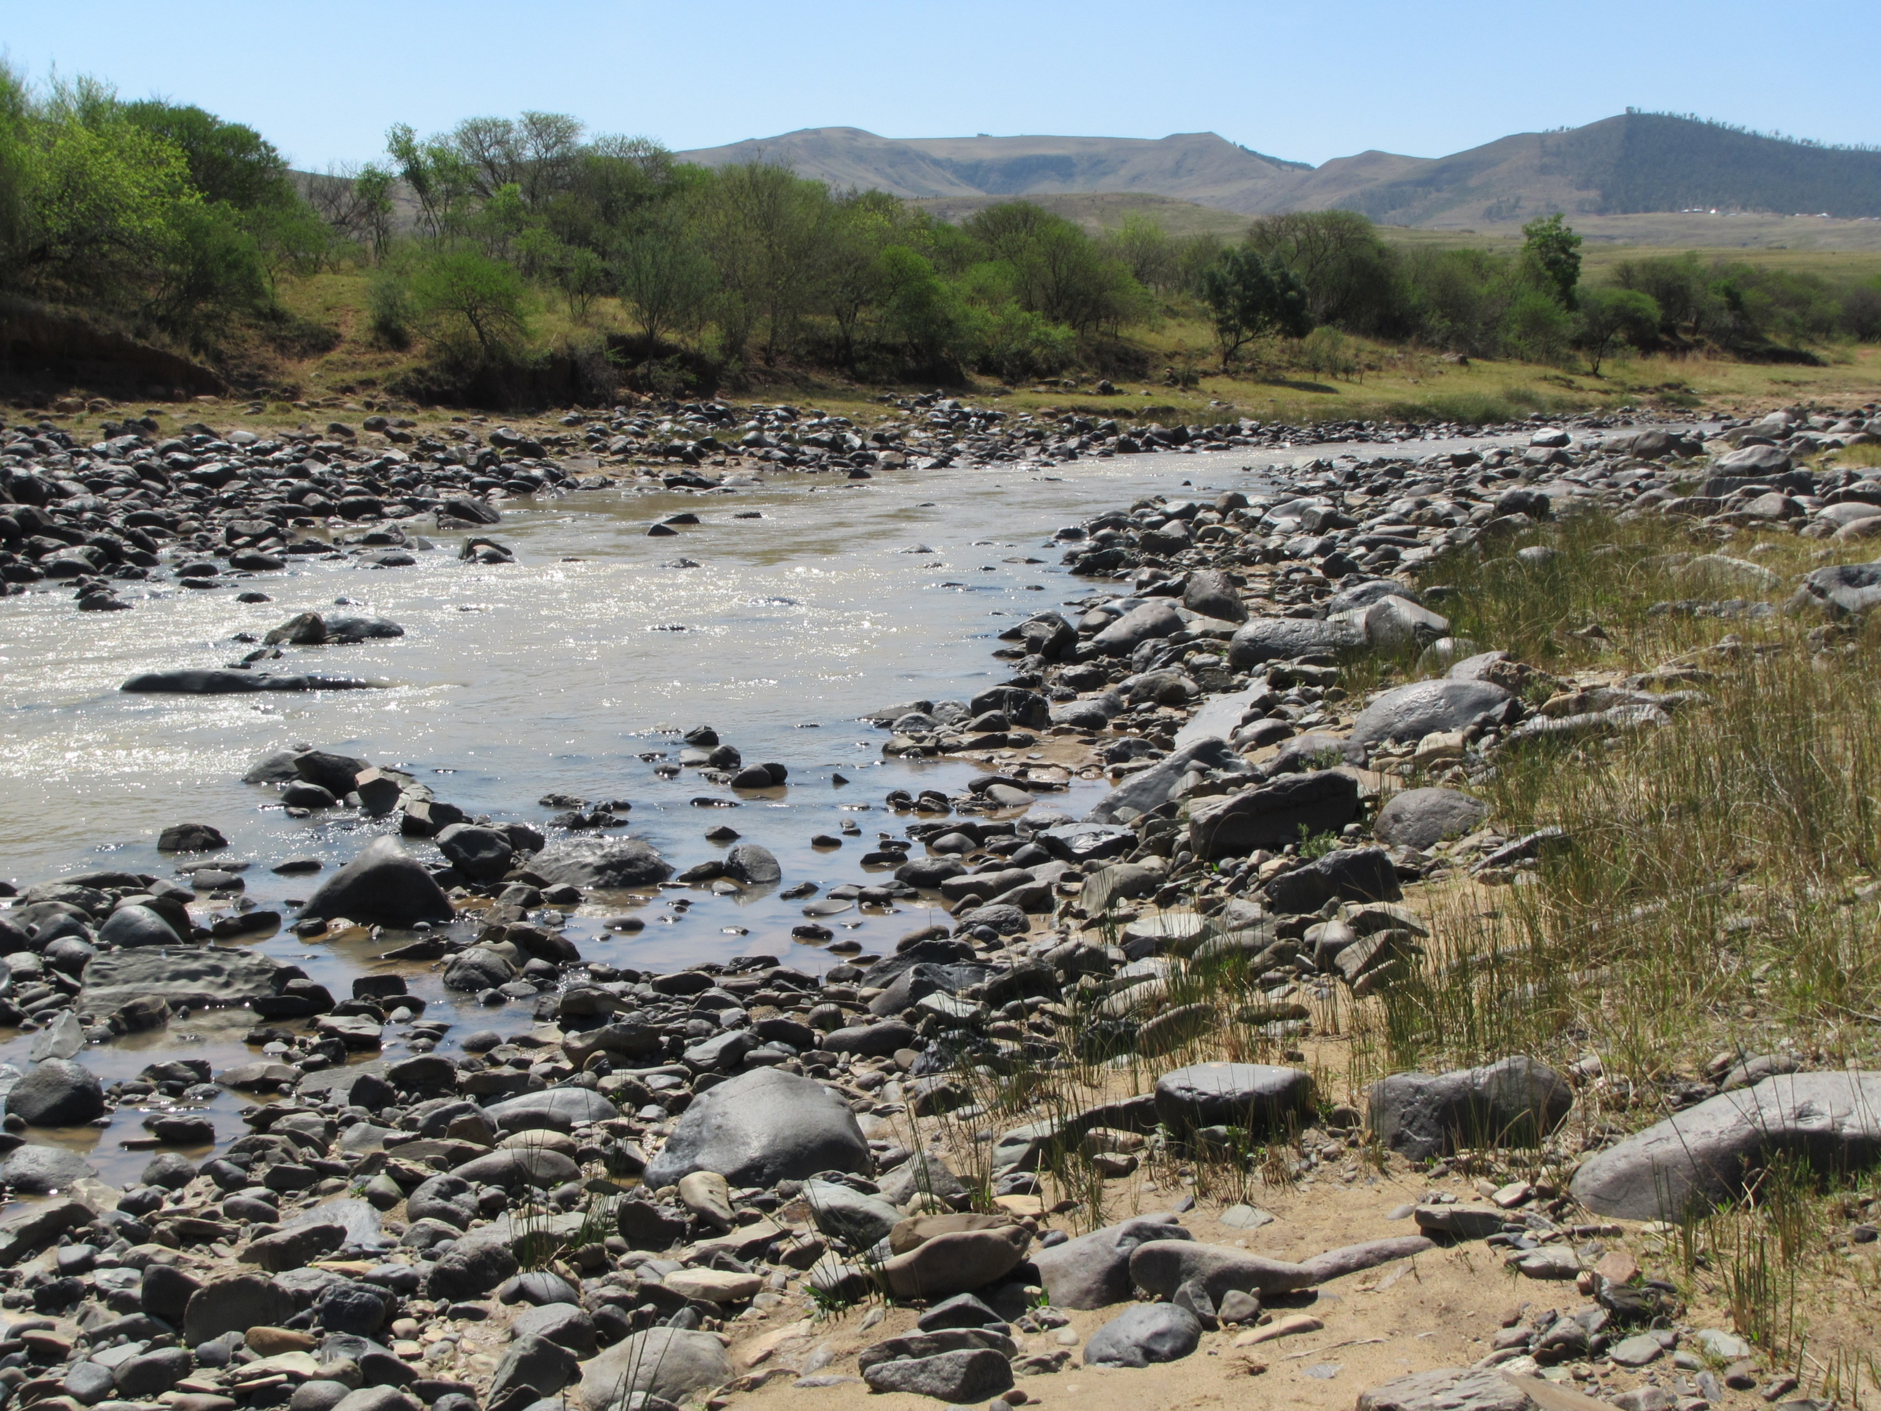
KINIRA RIVER - MZIMEWR3
 |  | PES / TEC
Hydrology | nMAR% | 33.3
 | Drought (90%) Aug | 1.647 m³/s
 | Aug (60%) | 3.037 m³/s
Habitat & Biota (EcoStatus C) | Geomorph | C
 | Fish | C
 | Invertebrates | C
 | Vegetation | C/D

Slide 10
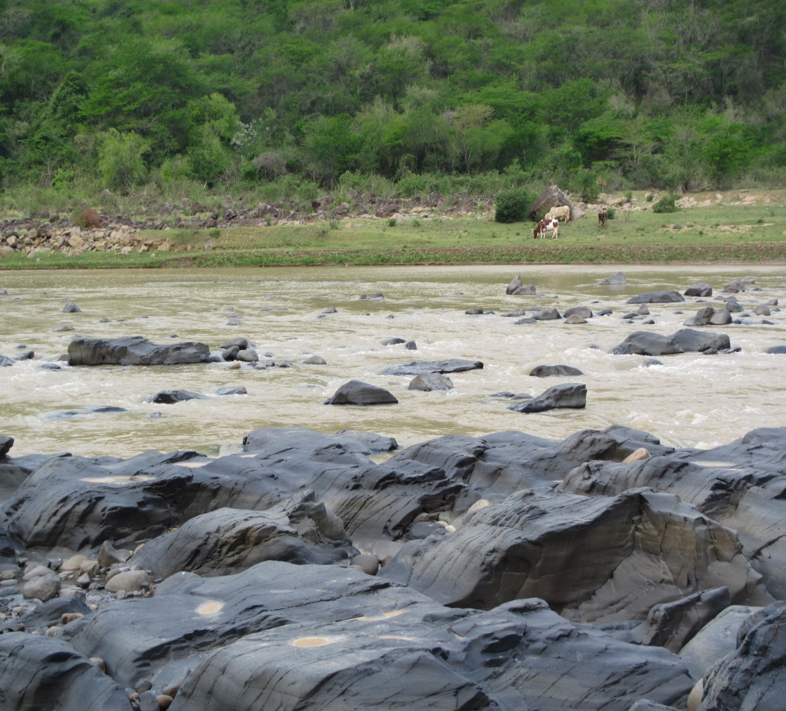
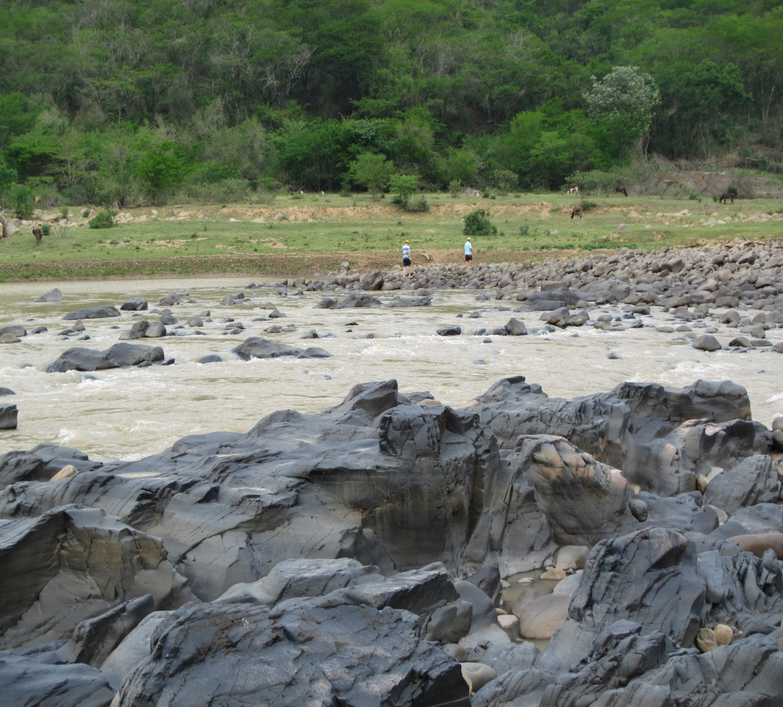
MZIMVUBU RIVER - MZIMEWR 4
 |  | PES | TEC
Hydrology | nMAR% | 23.8 | 23.8 - natural
 | Drought (90%) Aug | 3.12 m³/s | 3.12 - natural m³/s
 | Aug (60%) | 4.95 m³/s | 4.95 - natural m³/s
Habitat & Biota (EcoStatus C) | Geomorph | C | C
 | Fish | C | C
 | Invertebrates | C | C
 | Vegetation | C/D | C/D

Slide 11
MODERATE OR LOW PRIORITY RUs
(1 OR 2)
Broad RQOs for the EcoStatus Ecological Category representing the TEC (see handout) .
Largely qualitative with numerical info where possible.
Broad information for the EcoStatus category is provided for.

Slide 12
MODERATE OR LOW PRIORITY RUs
(1 OR 2) cont.
Where non-flow related factors are the drivers:
Riparian veg: Alien plan species, Riparian zone continuity and fragmentation
Where flow related factors are the drivers:
Fish: Species richness, Primary and secondary indicator species.
Macroinvertebrates: Water quality, flow, habitat and depth for the expected taxa (list provided).

Slide 13
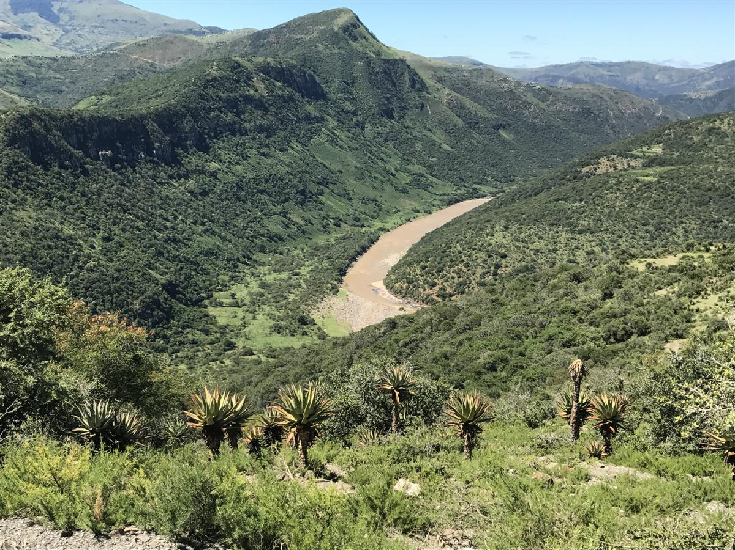
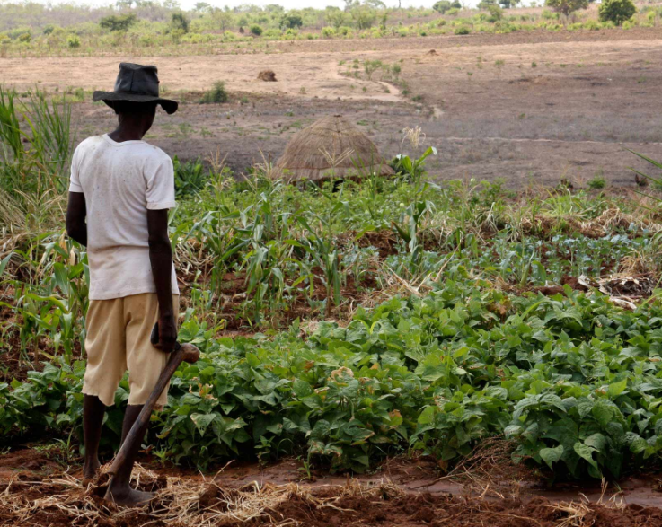
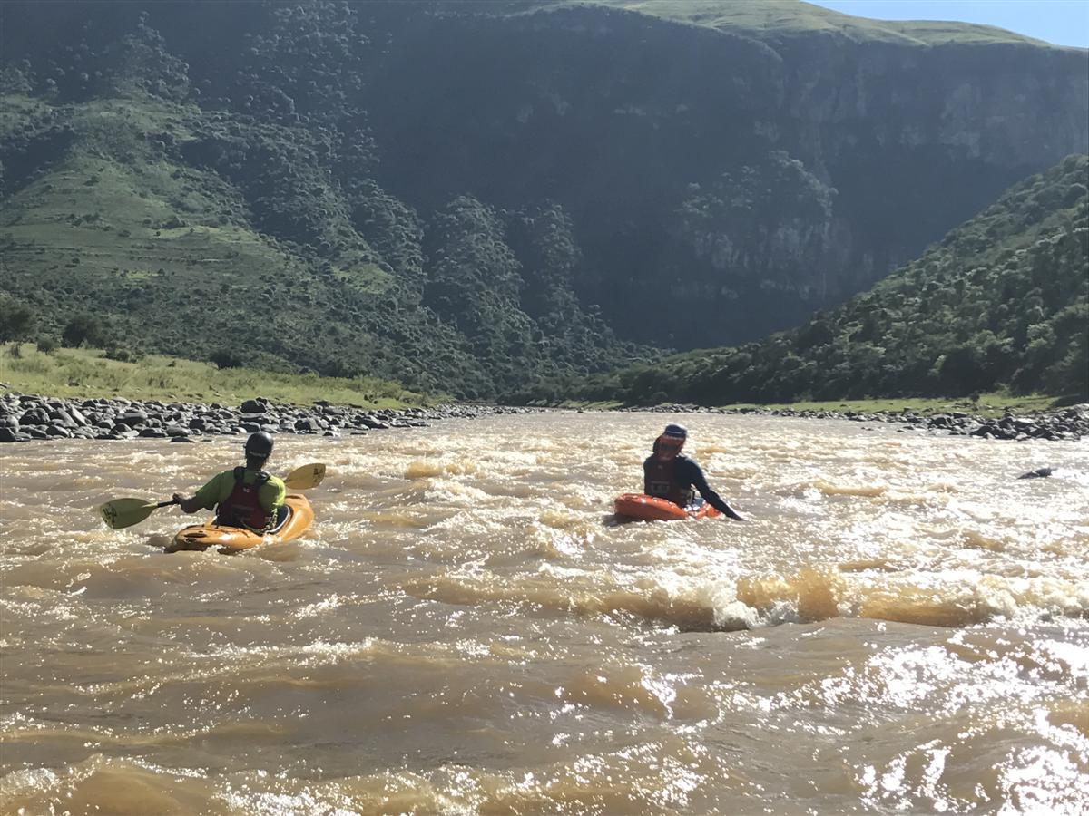
USER
WATER QUALITY
AND RQOs

Slide 14
Water quality = two broad components
  Ecological, i.e. as part of the EWR or Reserve process. Output = EcoSpecs.
  Non-ecological or Users, i.e. UserSpecs (excl. aquatic ecosystems + includes users such as irrigation, stock-watering, domestic, recreation and industrial).
Wq preparation for Step 6:
  ID wq role players, including non-ecological e.g. irrigation, settlements
  Start identifying indicators linked to driving variables associated with indicator wq role players, e.g. elevated phosphate associated with nutrients linked to stock-watering
  Aim is to identify pollution priority areas and / or priority protection areas

Slide 15
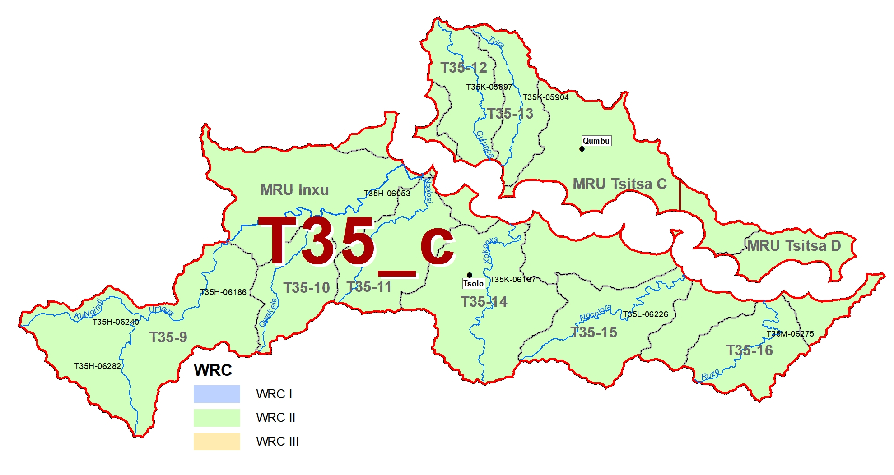
Land use: Extensive settlements; erosion + sedimentation.
Driving variables: Nutrients, faecal coliforms/E.coli
Land use: Ugie WWTW; urban impacts; irrigation downstream.
Driving variables: Nutrients, toxics, faecal coliforms/E.coli
Land use: Tsolo WWTW; urban impacts; crossings; dryland cultivation.
Driving variables: Nutrients, toxics, turbidity, faecal coliforms/E.coli

Slide 16
      Water quality portion of the RQOs = the most stringent objectives considering all users.
      Narrative and qualitative statements used to describe water quality objectives.
      Numerical limits provide a quantitative measure to be used for monitoring purposes and auditing compliance.
      WQ RQOs are expressed as Ideal to Tolerable in the gazette.
      Where objectives for aquatic ecosystems are not available from a Reserve study, water quality guidelines for aquatic ecosystems are used.
      Note that Reserve data available as A-F categories are converted to Ideal to Tolerable categories, as follows:
Categories A and A/B: Ideal
Categories B, B/C and C: Acceptable
Categories C/D and D: Tolerable

Slide 17
ASSUMPTIONS + RULES WHEN
SETTING WQ RQOs
Not set for dams.
Values used for setting RQOs are linked to standard DWS methods + manuals, e.g. PO4-P and not total phosphate.
Assumption: Run-of-river water is not used for domestic use UNLESS primary treatment has been undertaken.
RQOs set based on real data where available (so high confidence).
Where extrapolated, or land-use and other available information sources used, confidence is lower and RQOs will only become applicable once a database of information has been set up through monitoring.
E. coli and faecal coliforms objectives set below each WWTW, town and large settlement.
Where data not available (e.g. metals, fertilizers), biotic response and biological monitoring may be used as toxicity objectives.

Slide 18
COMPLETING WQ RQO TABLES
Source: Water quality assessment was conducted as part of the Mzimkhulu River Catchment Water Resources Study: Riverine Ecological Requirements study (DWA, 2011c). EcoSpecs and TPCs are taken from DWA (2011c).
Model: PAI model (DWAF, 2008b).
Users: Irrigation; erosion.
Water quality issue: Nutrients, salts, turbidity.
Narrative and Numerical: Details for MRU MzA are provided in Tables 7.1 and 7.2. Data used for water quality assessments should be collected from T5H004Q01.

Slide 19
QUESTIONS FOR CLARIFICATION

